Slide 1
Full Stack Development with Node.js, Angular, NativeScript and NoSQL
Nic Raboy | @nraboy

Slide 2
The Agenda
The importance of full-stack development
The different parts of the application stack
Taking control of your data with Couchbase NoSQL
Creating a RESTful API with Node.js
Developing an Angular web application
Developing a NativeScript with Angular mobile application

Slide 3
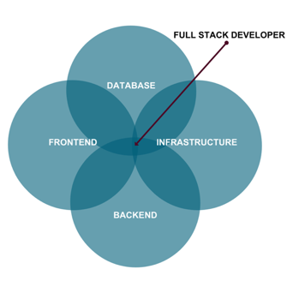
The Role of a Full-Stack Developer

Slide 4
The Breakdown of a Stack
Client Frontend
Desktop
Mobile
IoT
Backend
Web Application
Authentication
Middleware
Database

Slide 5
Our Stack
Client Frontend
Angular
Android
iOS
Backend
Web Application
Couchbase

Slide 6
Couchbase: The Complete Database Solution
Couchbase Lite
Sync Gateway
Couchbase Server
EMBEDDED DATABASE
SYNCHRONIZATION
DATABASE SERVER
Lightweight embedded NoSQL database with full CRUD and query functionality.
Secure web gateway with synchronization, REST, stream, batch and event APIs for accessing and synchronizing data over the web.
Highly scalable, highly available, high performance NoSQL database server.
SECURITY
Built-in enterprise level security throughout the entire stack includes user authentication, user and role based data access control (RBAC), secure transport (TLS), and 256-bit AES full database encryption.

Slide 7
Couchbase Lite Overview
Cross-platform support for all major operating systems and platforms
Built native from the ground up
500kb for most platforms
256-bit AES full database encryption
Couchbase Lite
Embedded Database
7

Slide 8
Sync Gateway Overview
Synchronize data between Couchbase Lite and Couchbase Server
REST, Stream, Batch, and Event APIs
Pluggable authentication
Fine grained user and role based access control
Elastically scalable in real-time
Sync Gateway
Synchronization
8

Slide 9
Couchbase Server Overview
Scale easily to thousands of nodes
Consistent high performance that supports millions of concurrent users
Flexible JSON data model
24x365 always-on availability
Couchbase Server
Database Server
9

Slide 10
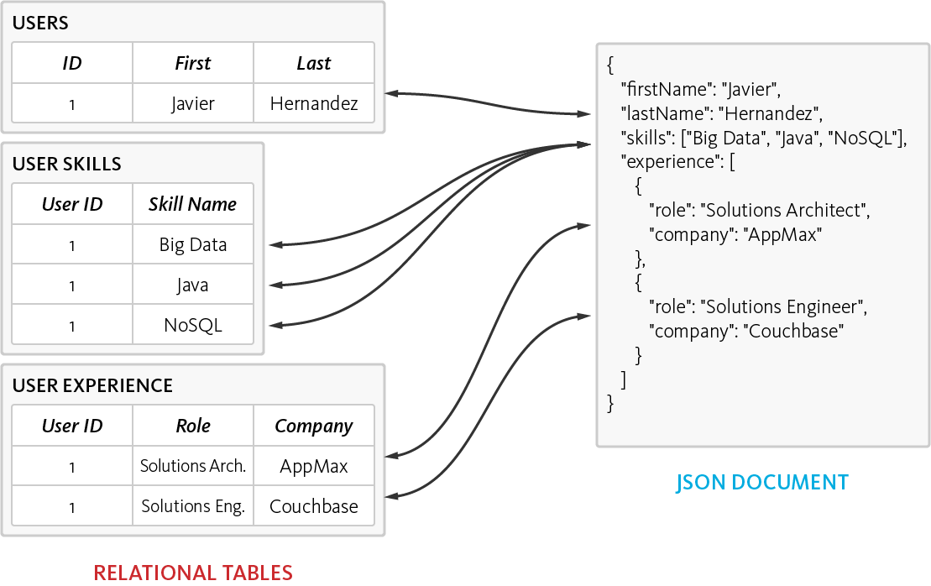
The Power of the Flexible JSON Schema
Ability to store data in multiple ways
De-normalized single document, as opposed to normalizing data across multiple table
Dynamic Schema to add new values when needed

Slide 11

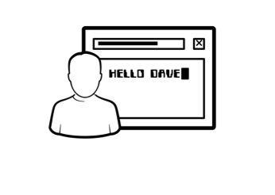
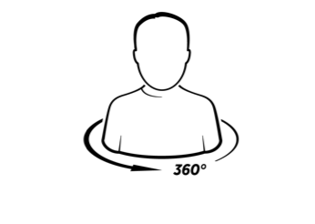
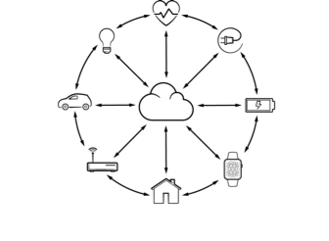
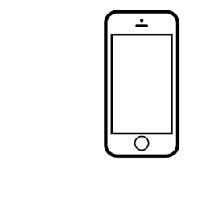
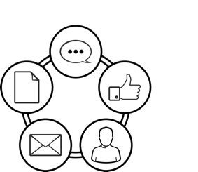
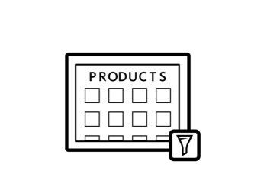
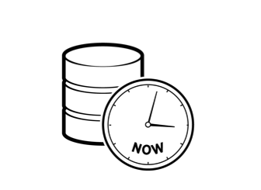


Top Use Cases
Profile Management
Personalization
360º Customer View
Internet of Things
Mobile Applications
Content Management
Catalog
Real Time Big Data
Digital Communication
High Availability Caching

Slide 12
Workshop Goals
Deploy a Couchbase Server instance
Create a RESTful API with Express Framework
Consume the RESTful API with Angular
Consume the RESTful API with NativeScript

Slide 13
Workshop Material
https://github.com/couchbaselabs/music-city-code-workshop

Slide 14
Node.js with Couchbase Server

Slide 15
Building Applications with Node.js SDK
//including the Node.js dependency
var Couchbase = require(”couchbase");
//connecting to a Couchbase cluster
var cluster = new Couchbase.Cluster("couchbase://localhost:8091");
//opening a bucket in the cluster
var myBucket = cluster.openBucket("travel-sample", "");
//preparing N1ql
var myQuery = Couchbase.N1qlQuery();
//creating and saving a Document
var document = {
firstname: "Nic",
lastname: "Raboy"
};
myBucket.insert("my-key", document, function(error, result) {});

Slide 16
Node.js with Couchbase
function query(sql, done) {
var queryToRun = myQuery.fromString(sql);
myBucket.query(queryToRun, function(error, result) {
if(error) {
console.log(“ERROR: “, error);
done(error, null);
return;
}
done(null, result);
return;
});
}

Slide 17
Node.js with Couchbase
function query(sql, done) {
var queryToRun = myQuery.fromString(sql);
myBucket.query(queryToRun, function(error, result) {
if(error) {
console.log(“ERROR: “, error);
done(error, null);
return;
}
done(null, result);
return;
});
}

Slide 18
Node.js with Couchbase
function query(sql, done) {
var queryToRun = myQuery.fromString(sql);
myBucket.query(queryToRun, function(error, result) {
if(error) {
console.log(“ERROR: “, error);
done(error, null);
return;
}
done(null, result);
return;
});
}

Slide 19
Node.js with Couchbase
function query(sql, done) {
var queryToRun = myQuery.fromString(sql);
myBucket.query(queryToRun, function(error, result) {
if(error) {
console.log(“ERROR: “, error);
done(error, null);
return;
}
done(null, result);
return;
});
}

Slide 20
Node.js with Couchbase
function query(sql, done) {
var queryToRun = myQuery.fromString(sql);
myBucket.query(queryToRun, function(error, result) {
if(error) {
console.log(“ERROR: “, error);
done(error, null);
return;
}
done(null, result);
return;
});
}

Slide 21
Node.js with Couchbase
function query(sql, done) {
var queryToRun = myQuery.fromString(sql);
myBucket.query(queryToRun, function(error, result) {
if(error) {
console.log(“ERROR: “, error);
done(error, null);
return;
}
done(null, result);
return;
});
}

Slide 22
Node.js Configuration
// config.json
{
"couchbase": {
"server": "couchbase://localhost",
"bucket": "restful-sample"
}
}

Slide 23
Node.js Configuration
// Project’s app.js file
var express = require("express");
var bodyParser = require("body-parser");
var couchbase = require("couchbase");
var path = require("path");
var config = require("./config");
var app = express();

Slide 24
Node.js Configuration
// app.js continued…
app.use(bodyParser.json());
app.use(bodyParser.urlencoded({ extended: true }));
module.exports.bucket = (new
couchbase.Cluster(config.couchbase.server)).openBucket(config.couchbase.bucket);
var routes = require("./routes/routes.js")(app);
var server = app.listen(3000, function () {
console.log("Listening on port %s...", server.address().port);
});

Slide 25
Node.js Upsert Document Function
// recordmodel.js
RecordModel.save = function(data, callback) {
var jsonObject = {
type: “user”,
firstname: data.firstname,
lastname: data.lastname,
email: data.email
}
var documentId = data.document_id ? data.document_id : uuid.v4();
db.upsert(documentId, jsonObject, function(error, result) {
if(error) {
return callback(error, null);
}
callback(null, {message: "success", data: result});
});
}

Slide 26
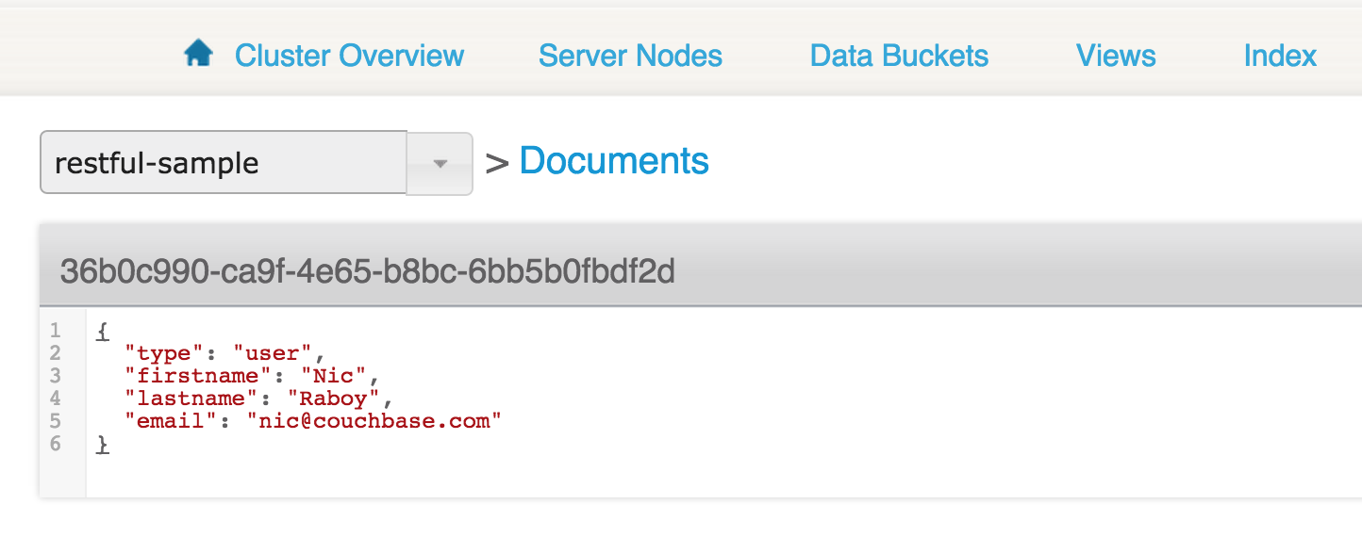
Couchbase JSON Document

Slide 27
Node.js Get Document with N1QL Function
// recordmodel.js continued…
RecordModel.getByDocumentId = function(documentId, callback) {
var statement = "SELECT firstname, lastname, email " +
"FROM `" + config.couchbase.bucket + "` AS users " +
"WHERE META(users).id = $1";
var query = N1qlQuery.fromString(statement);
db.query(query, [documentId], function(error, result) {
if(error) {
return callback(error, null);
}
callback(null, result);
});
};

Slide 28
Node.js Delete Document Function
// recordmodel.js continued…
RecordModel.delete = function(documentId, callback) {
db.remove(documentId, function(error, result) {
if(error) {
callback(error, null);
return;
}
callback(null, {message: "success", data: result});
});
};

Slide 29
Node.js Create or Update Endpoint
// routes.js
app.post("/api/create", function(req, res) {
if(!req.body.firstname) {
return res.status(400).send({"status": "error", "message": ”First Name?"});
}
// …
RecordModel.create(req.body, function(error, result) {
if(error) {
return res.status(400).send(error);
}
res.send(result);
});
});

Slide 30
Node.js Get Document Endpoint
// routes.js continued…
app.get("/api/get", function(req, res) {
if(!req.query.document_id) {
return res.status(400).send({"status": "error", "message": ”Document ID?"});
}
RecordModel.getByDocumentId(req.query.document_id, function(error, result) {
if(error) {
return res.status(400).send(error);
}
res.send(result);
});
});

Slide 31
Node.js Delete Endpoint
// routes.js continued…
app.post("/api/delete", function(req, res) {
if(!req.body.document_id) {
return res.status(400).send({"status": "error", "message": ”ID?"});
}
RecordModel.delete(req.body.document_id, function(error, result) {
if(error) {
return res.status(400).send(error);
}
res.send(result);
});
});

Slide 32
Workshop Part #1

Slide 33
Building an Angular Front-End

Slide 34
The Angular Command Line Interface
Generates boilerplate code
Live-reloading when changes are detected
Error catching
npm install –g @angular/cli

Slide 35
The Angular Command Line Interface
ng new project-name
ng g component component-name
ng serve
ng build

Slide 36
Angular Module
// ...
import { AppComponent } from './app.component';
import { MyComponent } from './example/example.component’;
@NgModule({
declarations: [
AppComponent,
MyComponent
],
imports: [
BrowserModule,
HttpModule,
AppRoutingModule
],
providers: [],
bootstrap: [AppComponent]
})
export class AppModule { }

Slide 37
Angular Router
import { NgModule } from "@angular/core";
import { RouterModule } from "@angular/router";
import { Routes } from "@angular/router";
import { MyComponent } from "./example/example.component";
const routes: Routes = [
{ path: ”example", component: MyComponent },
];
@NgModule({
imports: [RouterModule.forRoot(routes)],
exports: [RouterModule]
})
export class AppRoutingModule { }

Slide 38
Angular Component
import { Component, OnInit } from '@angular/core';
import { Http } from "@angular/http";
@Component({
selector: 'app-example',
templateUrl: './example.component.html',
styleUrls: ['./example.component.css']
})
export class MyComponent implements OnInit {
public constructor(private http: Http) {
// Variable initialization
}
public ngOnInit() {
// Loading and app initialization
}
}

Slide 39
Angular HTML UI
<span>{{ data.firstname }}</span>
<div>
<input type="text" [(ngModel)]="data.firstname" />
<button type="button" (click)="save()">Save</button>
</div>

Slide 40
HTTP Requests Against an API
this.http.get("http://localhost:3000/example")
.map(result => result.json())
.subscribe(result => {
// Do something with result object
});

Slide 41
Workshop Part #2

Slide 42
Building a Mobile Front-End with NativeScript

Slide 43
The NativeScript Command Line Interface
Generates boilerplate code
Live-reloading when changes are detected
Error catching
npm install –g nativescript

Slide 44
The NativeScript Command Line Interface
tns create project-name --ng
tns plugin add plugin-name
tns run android --emulator
tns build android

Slide 45
NativeScript XML UI
<ActionBar title="{N} Example">
<ActionItem text="Save" ios.position="right" (tap)="save()"></ActionItem>
</ActionBar>
<StackLayout class="form">
<StackLayout class="input-field">
<Label text="First Name: {{ data.firstname }}" class="label"></Label>
<TextField [(ngModel)]="data.firstname" class="input"></TextField>
<StackLayout class="hr-light"></StackLayout>
</StackLayout>
</StackLayout>

Slide 46
Workshop Part #3

Slide 47
Project and Sample Applications
https://github.com/couchbaselabs/music-city-code-workshop
https://github.com/couchbaselabs/try-cb-nodejs
https://github.com/couchbaselabs/comply-nodejs

Slide 48
Where do you find us?
developer.couchbase.com
blog.couchbase.com
@couchbase / @couchbasedev / @nraboy
forums.couchbase.com
stackoverflow.com/questions/tagged/couchbase

